Slide 1
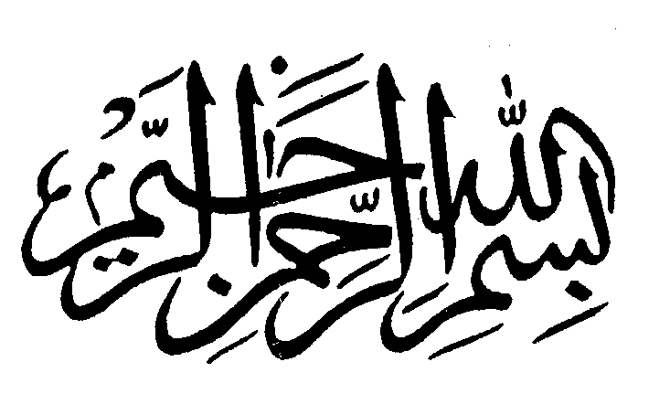
Understanding Allah’s Natural Pattern for Our Development
Imam Bashir Ali:
Midwest Leadership Conference
Cleveland, Ohio
April 2014

Slide 2
Holy Quran, Surah 30: 30
“So set your purpose/direction for religion rightly inclined, Allah’s natural pattern which he created (and evolved) man on. Let there be no change in the nature/creation which Allah has made. That is the ever-true faith, yet most men do not know.”

Slide 3
Imam W.D. Mohammed Tafseer
“G-d says that this is the religion of Fitraa, the pattern upon which He evolved human life. So there was a pattern existing before our existence and then G-d created us to be fitted upon that pattern.
…the whole creation is the teaching of G-d and He created the human intellect to live in that teaching environment.”
Imam W.D. Mohammed: Mohammed Speaks

Slide 4
“Pattern” Definition
“…something designed or used as a model for making things”
Merriam-Webster Dictionary

Slide 5
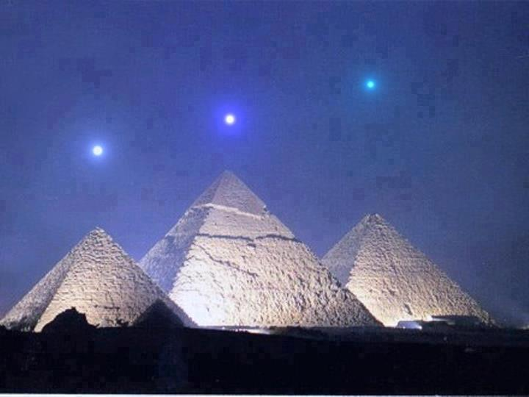
Allah’s Natural Pattern/ Universal Principles
Oneness/Unity/Connections
Dynamism (Natural Motion)
Diversity
Balance/Proportion
Rhythm/Harmony

Slide 6
Oneness/Unity/Connections
Creator
Creation
Humanity
Origin
Connected
1

Slide 7
Oneness/Unity/Connections
In Our Human Nature
Origin (Single Soul)
One Nature (Muslim)
One Family (Humanity)
One Community (Unity)
1

Slide 8
Oneness/Unity/Connections
In Our Community Life
Humanity
Society
Community
Family
Individual

Slide 9
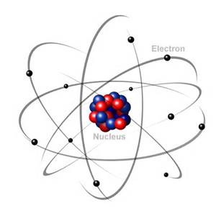
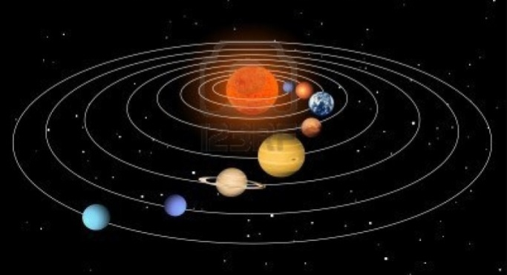
Dynamism (Natural Motion)
Power/Force/Energy/Motion/Action
Life
Time
Directional
Purposeful
Progressive

Slide 10
Dynamism (Natural Motion)
In Our Human Nature
Aspirations and Journey of the Soul
Stages/Progression of Life
Purpose
Direction
Destination

Slide 11
Dynamism (Natural Motion)
In Our Community Life
Time Dynamic
Change Dynamic
Progression Dynamic
Oneness/Diversity Dynamic

Slide 12
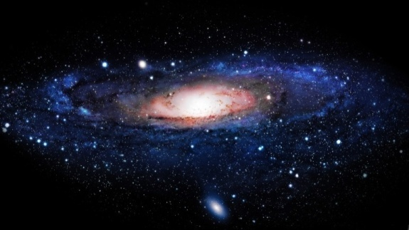
Diversity
Complementary
Interdependent
Unique

Slide 13
Diversity
In Our Human Nature
Complementary/Interdependence of Self (Physical, Emotional, Mental, Moral, Spiritual)
Complementary/Interdependence of Mates (Male and Female, Women and Men)
Uniqueness of the Self/Soul
Diversity of Talent and Purpose

Slide 14
Diversity
In Our Community Life
Our Social Roles (Men/Women)
Our Ethnicities
Our Languages and Geography
Our Traditions/Cultures/Beliefs
Institutions of Society

Slide 15
Oneness/Diversity Dynamic
Oneness
Dynamism
Dynamism
Diversity

Slide 16
Balance/Proportion
In Our Human Nature
The Sawaa (Perfect Balance) of the Soul
Our Physical Form
External (Symmetry, Motion)
Internal (Health)
Life Balance
Obligations
Needs
Aspirations

Slide 17
Balance/Proportion
In Our Community Life
Unity/Diversity Balance
Dynamism Balance
Fairness
Equality
Justice

Slide 18
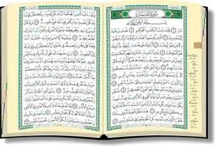
Rhythm/Harmony
In Our Human Nature
Rhythm/Harmony of Our Soul
Rhythm of Our Languages
Rhythm/Harmony of Our Ear/Heart/Mind
Rhythm/Harmony of Our Biology (Bio-rhythms)
Harmony of Our Relationships

Slide 19
Rhythm/Harmony
In Our Community Life
Rhythm/Harmony of Our Faith Expressions
Rhythm/Harmony of Our Cultural Expressions (i.e. Music, Poetry)
Rhythm/Harmony of Our Competitive Sports
Rhythms of History and Economic Cycles
Harmony of Our Social Interaction

Slide 20
In Summary…
“G-d says that He has established man on the order of the pattern found in the universe. He formed man to that pattern, and that is the pattern of behavior we call Islamic behavior.
..It is not until Revelation comes that man really finds his purpose on this earth, purpose in the universe, and his true satisfaction in his heart and soul.”
Imam W.D. Mohammed: Progressions Magazine August/September 1986

Slide 21
Community Development Discussion
Our Special History and Journey
Our Purpose/Mission?
Where we are now? (Present Challenges)
Where are we going? (Development Agenda)

Slide 22
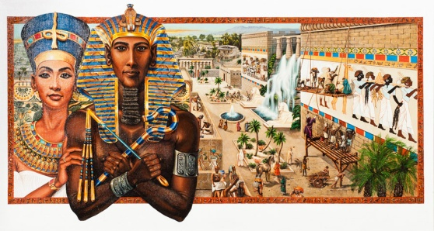
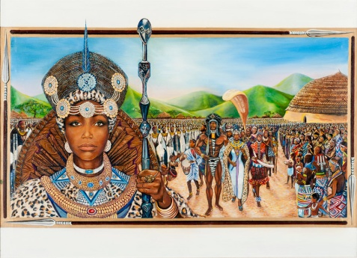
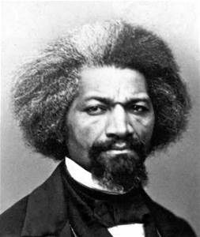
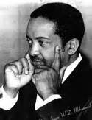
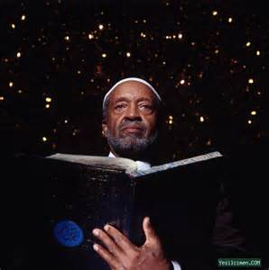
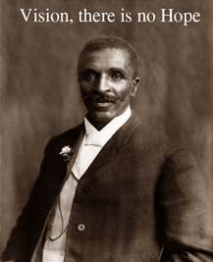
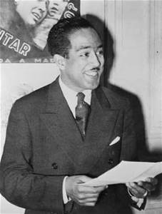
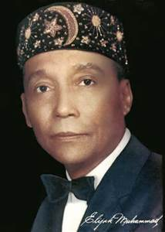
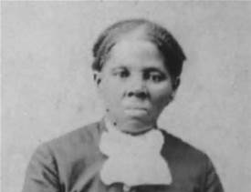
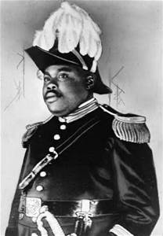
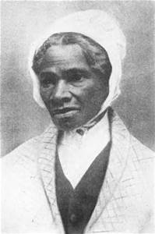
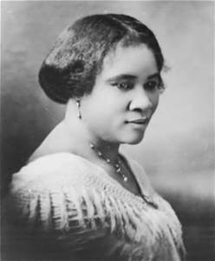
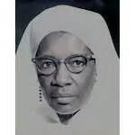
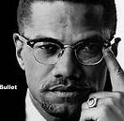
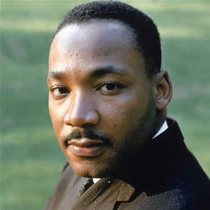
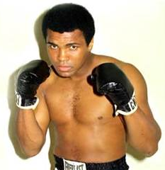
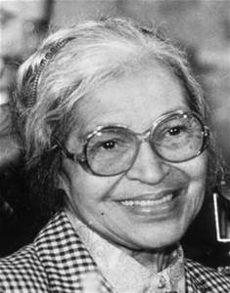
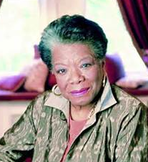
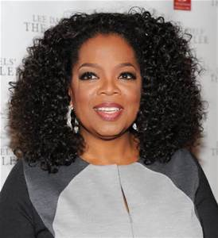
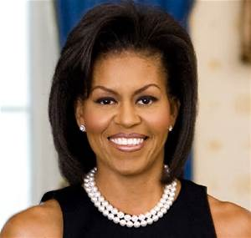
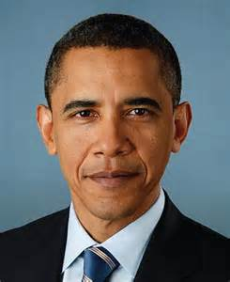
Community Development Discussion
Our Special History and Journey

Slide 23
Community Development Discussion
Our Purpose/Mission (HQ 3:104)
“Let there be from you a community inviting to the goodness/prosperity; commanding universally recognized human excellence; preventing influences that void the human nature. Those, they, will be the successful.”

Slide 24
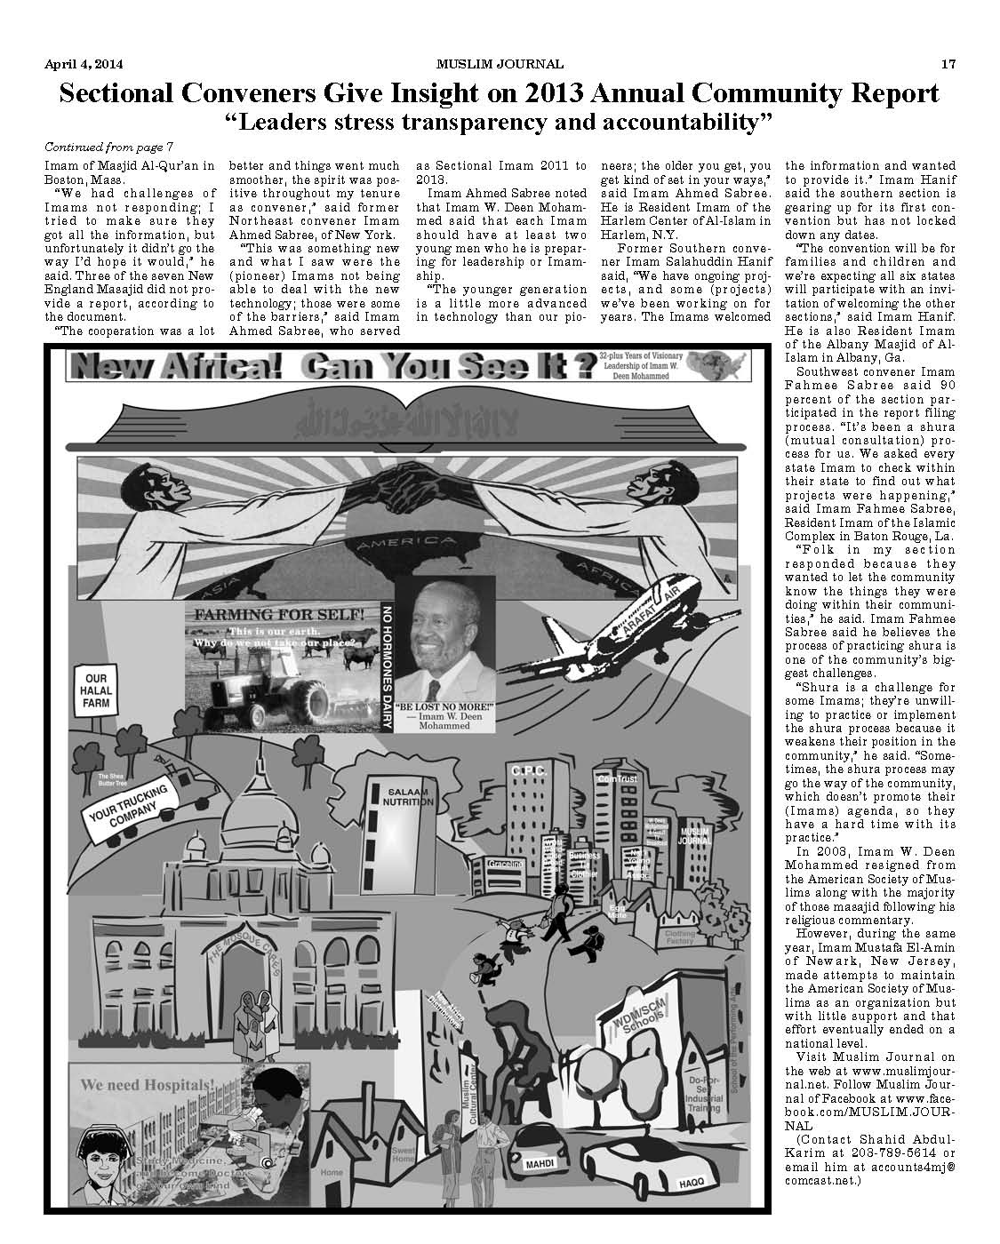
Community Development Discussion
Our Purpose/Mission (IWDM Vision)
“Remake the World”
“Islamic Democracy”
“Model Muslim Communities”
“New Africa”
“ Ummatul Islameeyah”
“Shared Freedom Space”

Slide 25
Community Development Discussion
Where are we now?
(Present Challenges)
Community in Transition
Natural Progression
Demographic Challenges
Infrastructure Challenges
Community Development Challenges

Slide 26
Community Development Discussion
Where are we going?(Development Agenda)
For the Sake of Allah:
Working Together to Build Community Life
Trusting, Loving, and Forgiving Each Other
Avoiding Divisive Behaviors
Questioning Each Other
Holding Each Other Accountable

Slide 27
Community Development Discussion
Where are we going? (Development Agenda)
Growing our Islamic knowledge, i.e.:
Knowledge of Quran, specifically the language of Quran;
Understanding the foundation, principles, and connections (natural pattern) of Allah’s creation;
Understanding the life, example, and practices of the Prophet Muhammad [PBUH];
Understanding natural, human, and Islamic history (including our own); and
Understanding the language and thinking of Imam W. Deen Mohammed).

Slide 28
Community Development Discussion
Where are we going? (Development Agenda)
Developing the critical institutions of community life:
Marriage and family life;
Education;
Economic and business development;
Culture;
Internal governance and external civic engagement;
Youth development; and
Leadership development.

Slide 29
Community Development Discussion
Where are we going?(Development Agenda)
Continue to develop Islamic democracy and governance through Shuraa Baynahum;
Develop our ability to communicate among the diversity of interests in our community;
Develop talent and skills for specific community needs (including the next generation of leaders);
Work together toward common objectives;

Slide 30
Community Development Discussion
Where are we going?
(Development Agenda)
Be transparent in our operations and accountable for results;
Communicate back to the community on progress;
Inviting others to learn and share our Islamic life (dawah); and
Learning from the best of other faith traditions and cultivating Interfaith relationships.

Slide 31
Community Development Discussion
Where are we going?(Development Agenda)
Other Issues?...
Questions?...
Discussion…

Slide 32
Understanding Allah’s Natural Pattern for Our Development
Shukran,
Peace and Blessings!

